Slide 1
User Manual
Install Visual Studio Code
Clone the Repository
Open the project with Visual Studio Code
Run the code in Terminal
GitHub URL: https://github.com/Ziyuan07/6005CEM_Security

Slide 2

Ecommerce Website 6005CEM_Security
Group 24: Quah Zhi Chao
Pang Zi Yuan

Slide 3

Our Website
The E-Commerce Website Project aimed to create a secure and user-friendly online shopping platform, providing a seamless shopping experience, secure transactions, and robust data protection.

Slide 4
Potential Security Issues
Security Aspect | Potential Security Issues
Authentication | Users might choose weak passwords, making it easier for attackers to gain unauthorized access.
Data Encryption | Sensitive data transmitted over the network may be intercepted by attackers.
Input Validation | Malicious input, such as SQL injection, might be used to manipulate the application.
Secure Communication | Attackers might intercept and manipulate data during communication.
Error Handling | Improper error handling may expose sensitive information to attackers.

Slide 5
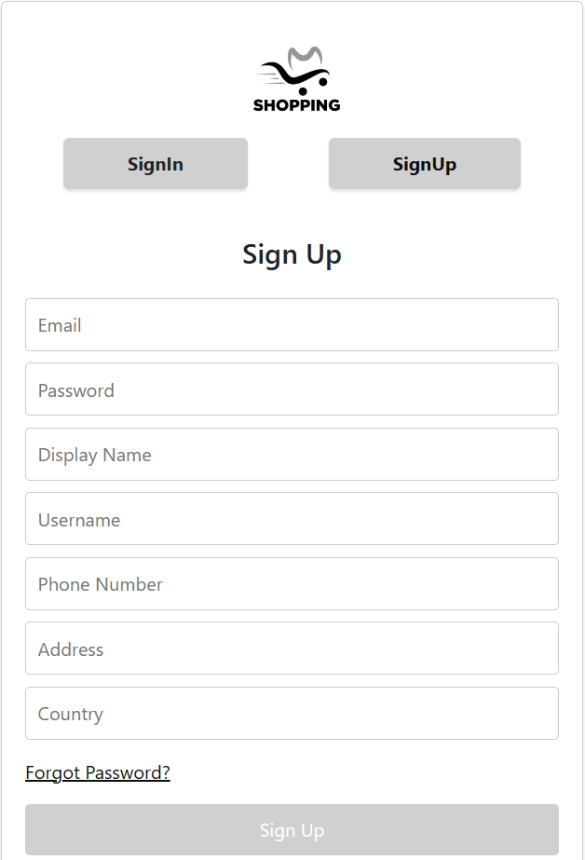
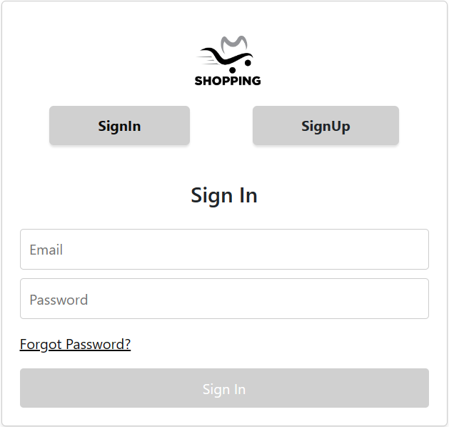
Sign Up & Sign In Features
Sign In Page
Sign Up Page

Slide 6
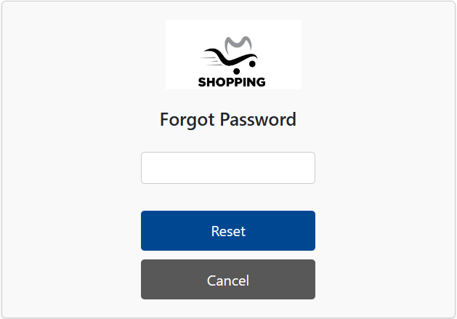
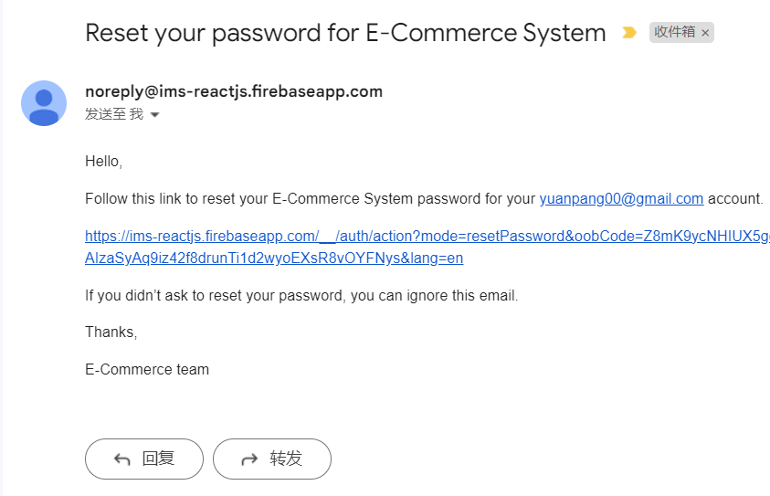
Reset Password Features
Reset Password Email
Reset Password

Slide 7
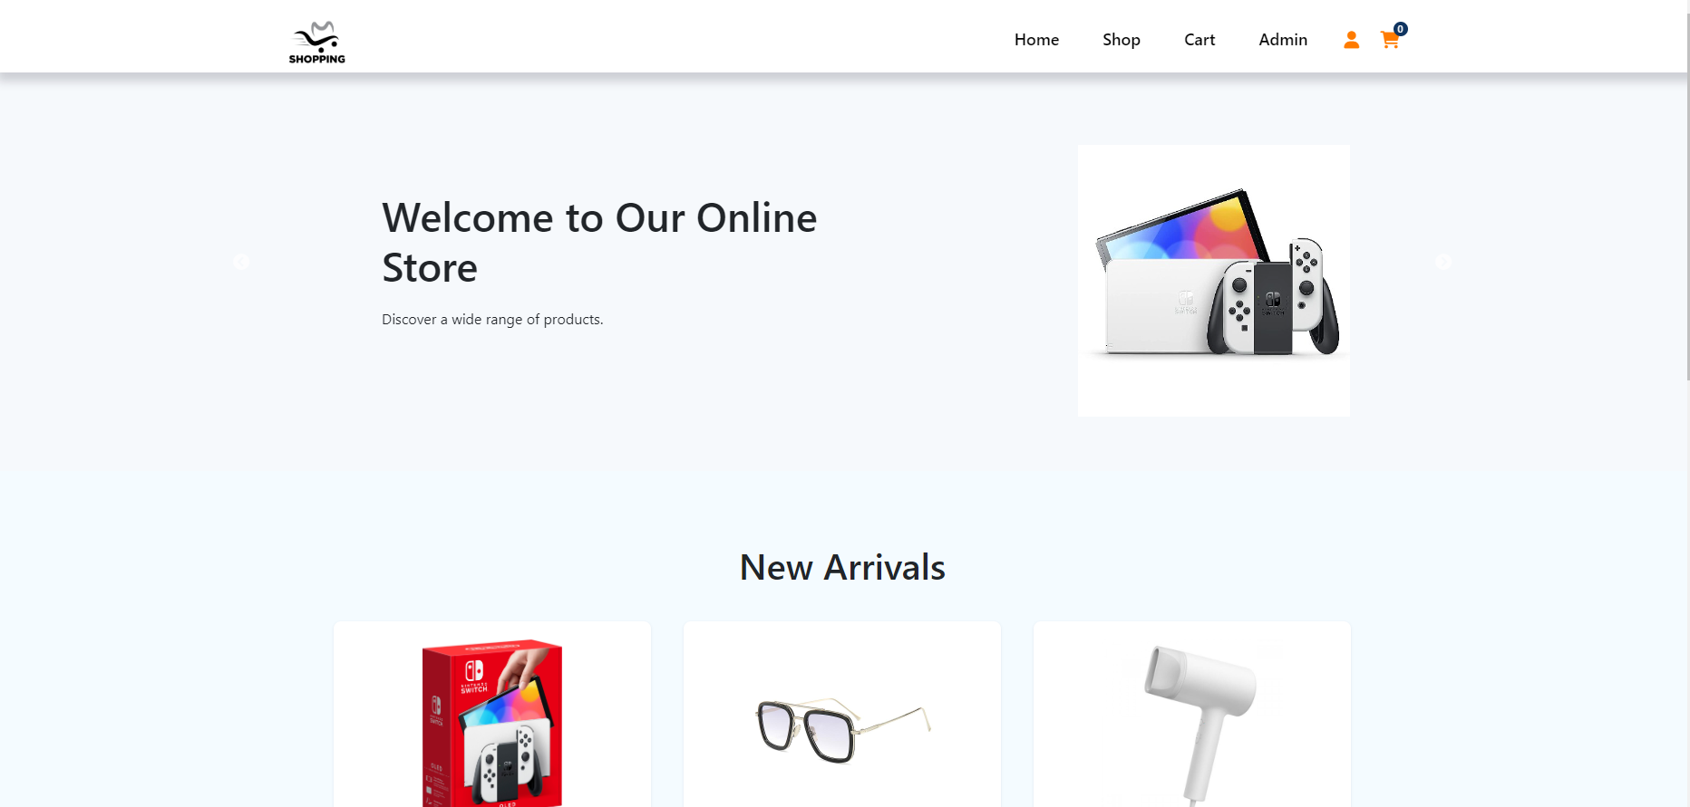
User Main Page

Slide 8
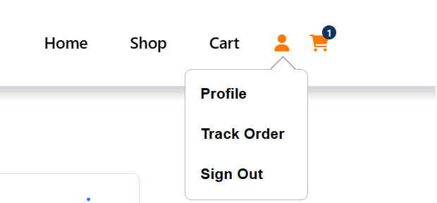
User sidebar

Slide 9
Authentication
Improvements and Future Considerations:
Consider integrating additional factors for multi-factor authentication (MFA).
Explore emerging authentication methods like WebAuthn for enhanced security.

Slide 10
Authentication
Chosen Authentication Mechanism:
Implemented the bcrypt algorithm for secure password hashing.
Significance lies in its ability to hash passwords in a way that resists brute-force attacks and pre-computed table attacks.

Slide 11
HTTPS Enforcement
HTTPS Implementation:
Configured the application to use HTTPS for secure communication.
Utilized a trusted SSL/TLS certificate for encrypting data in transit.

Slide 12
HTTPS Enforcement
Use of HSTS and Future Protocol Updates:
Implemented HTTP Strict Transport Security (HSTS) for additional security.
Future plans include staying updated with the latest SSL/TLS protocols and exploring the adoption of HTTP/3 for improved performance and security.

Slide 13
Role-Based Access Control (RBAC)
RBAC for User Roles and Permissions:
Utilized Role-Based Access Control (RBAC) to manage user roles and permissions.
Enhanced data confidentiality and integrity through well-defined access controls.

Slide 14
Role-Based Access Control (RBAC)
Introduction to Attribute-Based Access Control (ABAC):
Potential improvement involves exploring Attribute-Based Access Control (ABAC) for more flexible and dynamic access management.
ABAC allows policies based on various attributes, providing finer granularity in access control.

Slide 15
Data Encryption
In-Transit and At-Rest Encryption:
Ensured secure data transmission through HTTPS (in-transit encryption).
Implemented database-level encryption for sensitive information (at-rest encryption).

Slide 16
Data Encryption
Chosen Encryption Mechanisms and Potential Updates:
Utilized strong encryption algorithms such as AES for data protection.
Ongoing consideration for periodic updates to encryption protocols and ciphers to align with evolving standards.

Slide 17
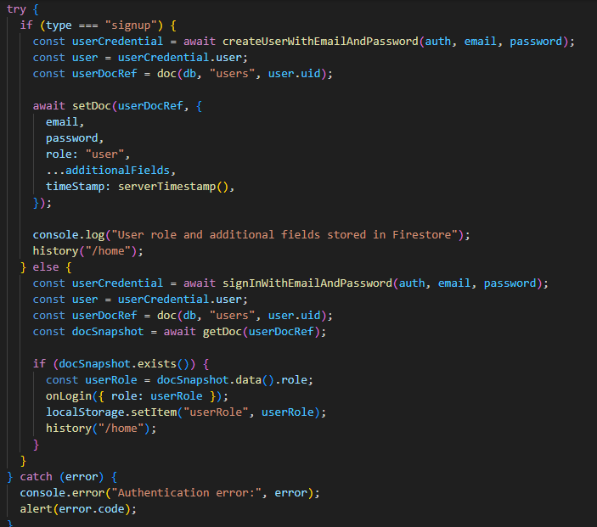
Authentication

Slide 18
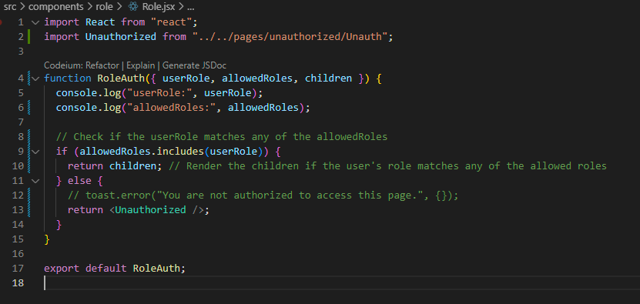
Role Authorization

Slide 19
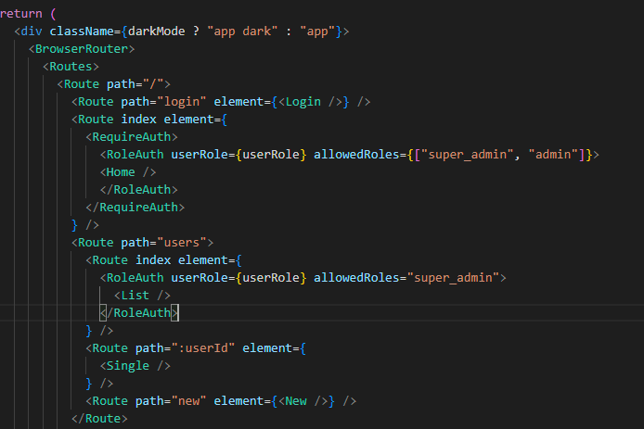
Roles Authentication Props

Slide 20
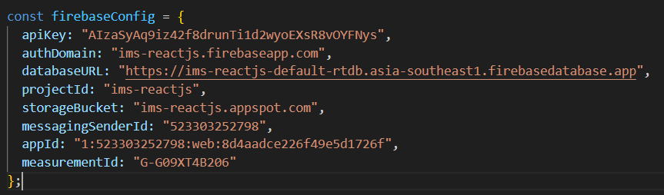
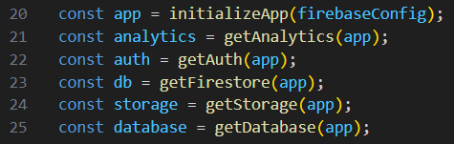
Firebase Configuration

Slide 21
Conclusion
Factors | Implemented
Level of Access | Added Admin
Input Validation/Output Encoding/ Error Validation | Encrypted Password
Secure Communication | HTTPS
Data Protection | Firebase Authentication
Logging & Analytics | Firebase Analytics

Slide 22

Thanks!

